Slide 1
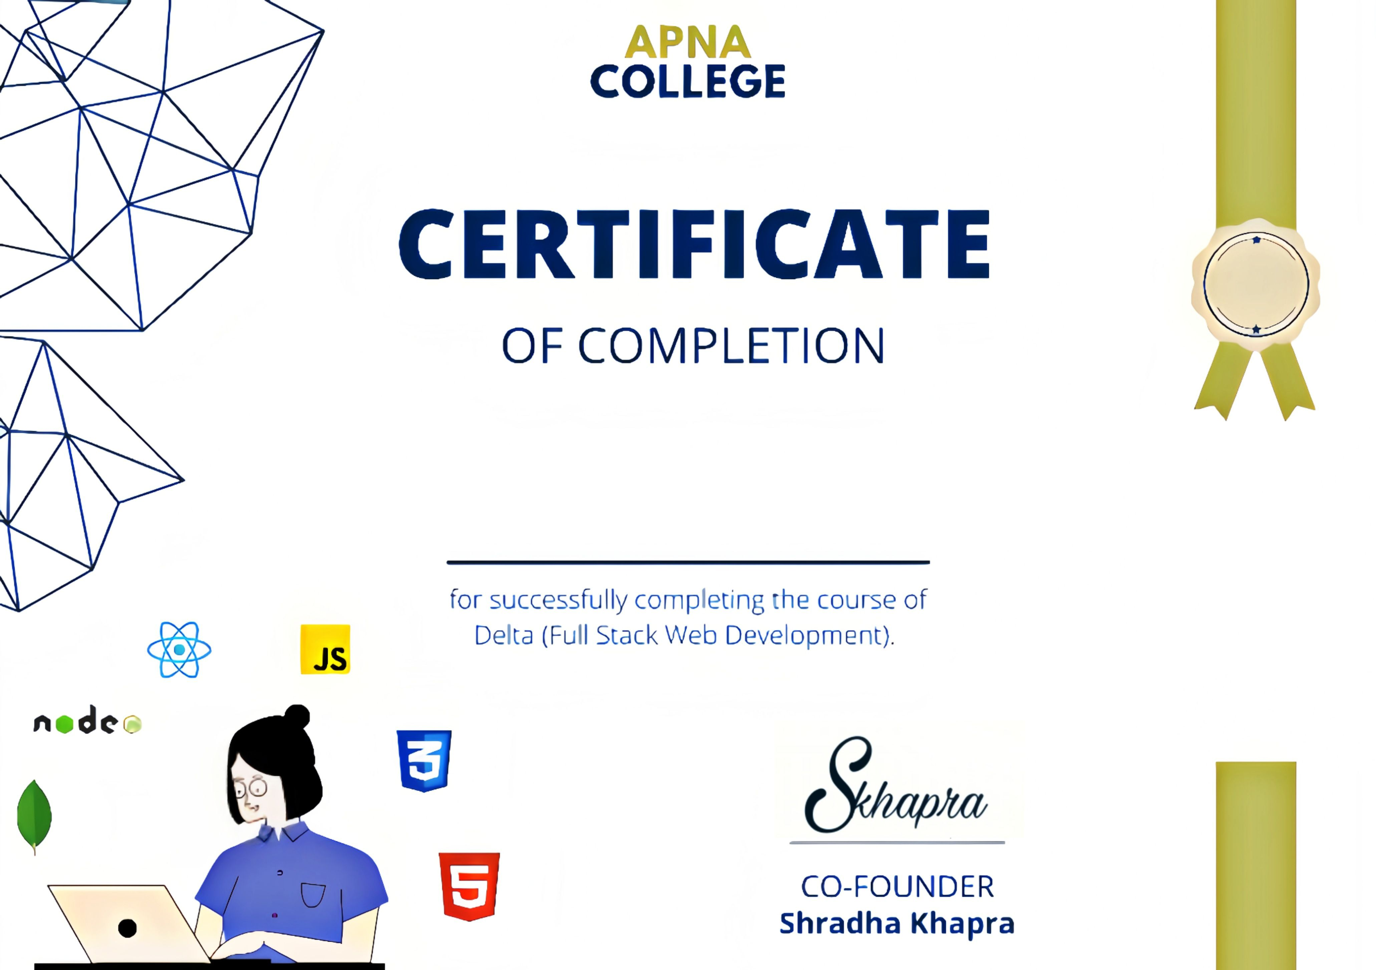
Ranjeet Tiwari

